Slide 1
Unit -1 Introduction to Visualization

Slide 2
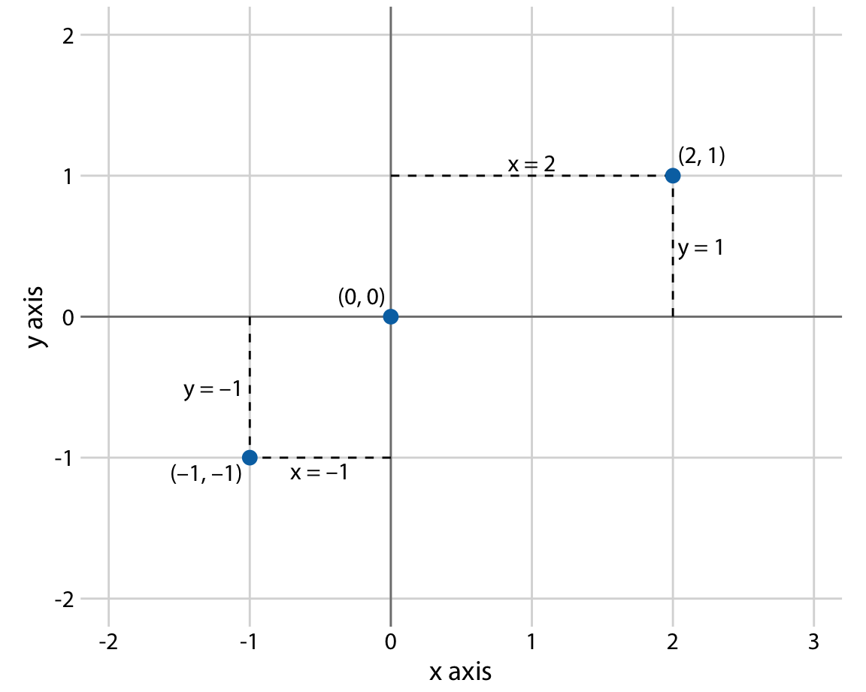
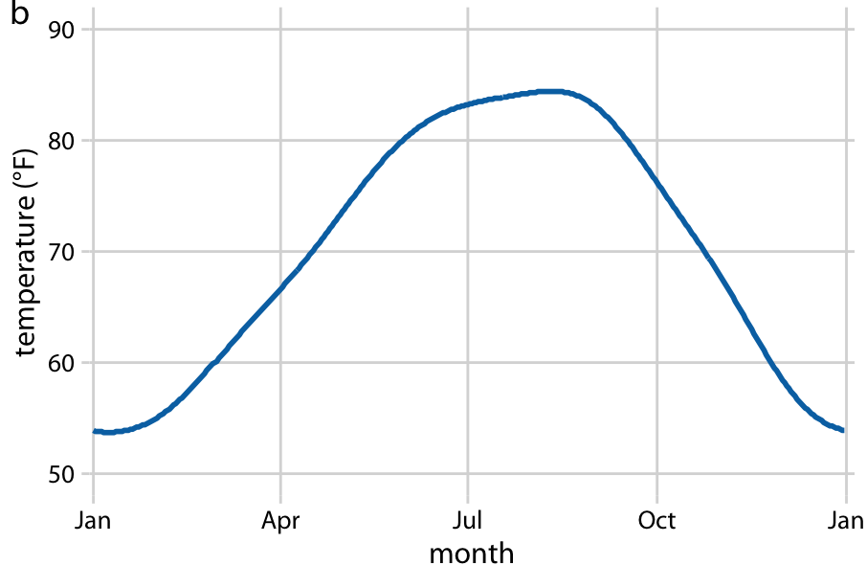
Cartesian coordinates
The x and y axes run orthogonally to each other, and data values are placed in an even spacing along both axes.
The two axes are continuous position scales, and they can represent both positive and negative real numbers.

Slide 3
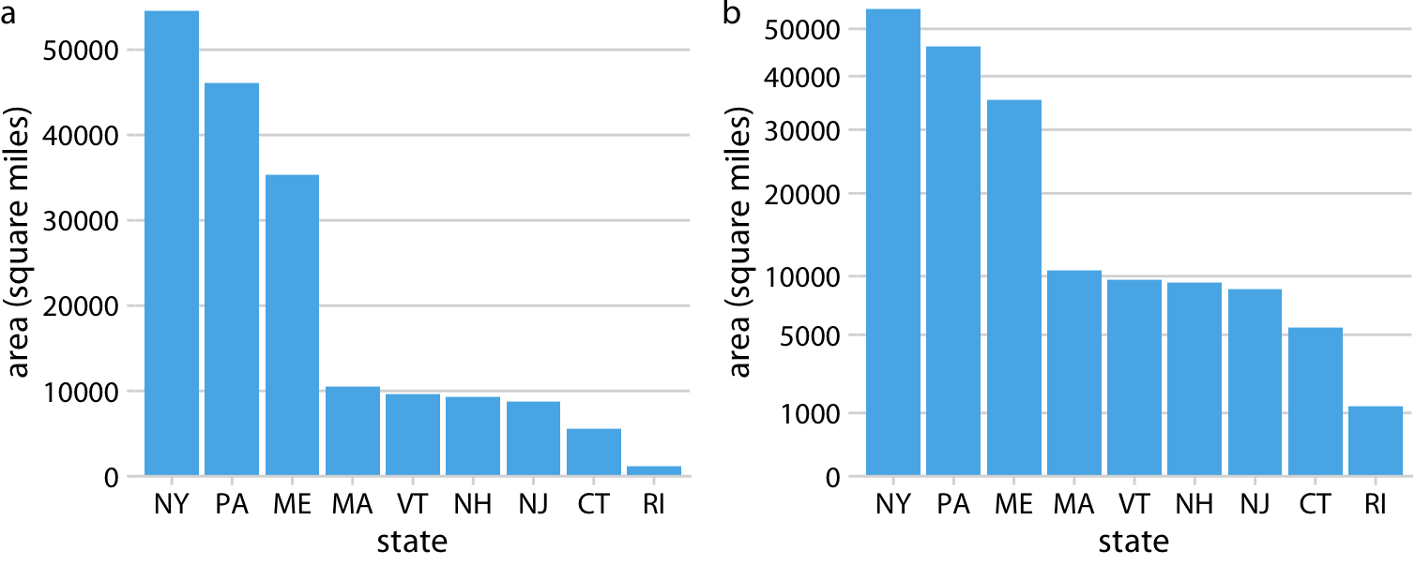
Nonlinear axes
In a nonlinear scale, even spacing in data units corresponds to uneven spacing in the visualization, or conversely even spacing in the visualization corresponds to uneven spacing in data units.
The most commonly used nonlinear scale is the logarithmic scale or log scale for short.

Slide 4
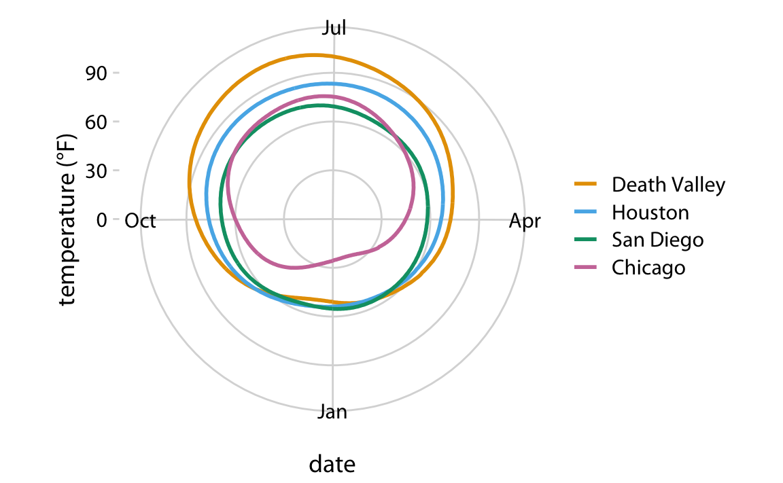
Coordinate systems with curved axes
There are other coordinate systems, however, where the axes themselves are curved.
The polar coordinate system, we specify positions via an angle and a radial distance from the origin, and therefore the angle axis is circular.
Polar coordinates can be useful for data of a periodic nature.

Slide 5
curved axes: Geospatial data
Maps, locations on the globe are specified by their longitude and latitude.
Earth is a sphere, drawing latitude and longitude as Cartesian axes is misleading and not recommended.
There are various types of non-linear projections that attempt to minimize artifacts and that strike different balances between conserving areas or angles relative to the true shape lines on the globe.

Slide 6
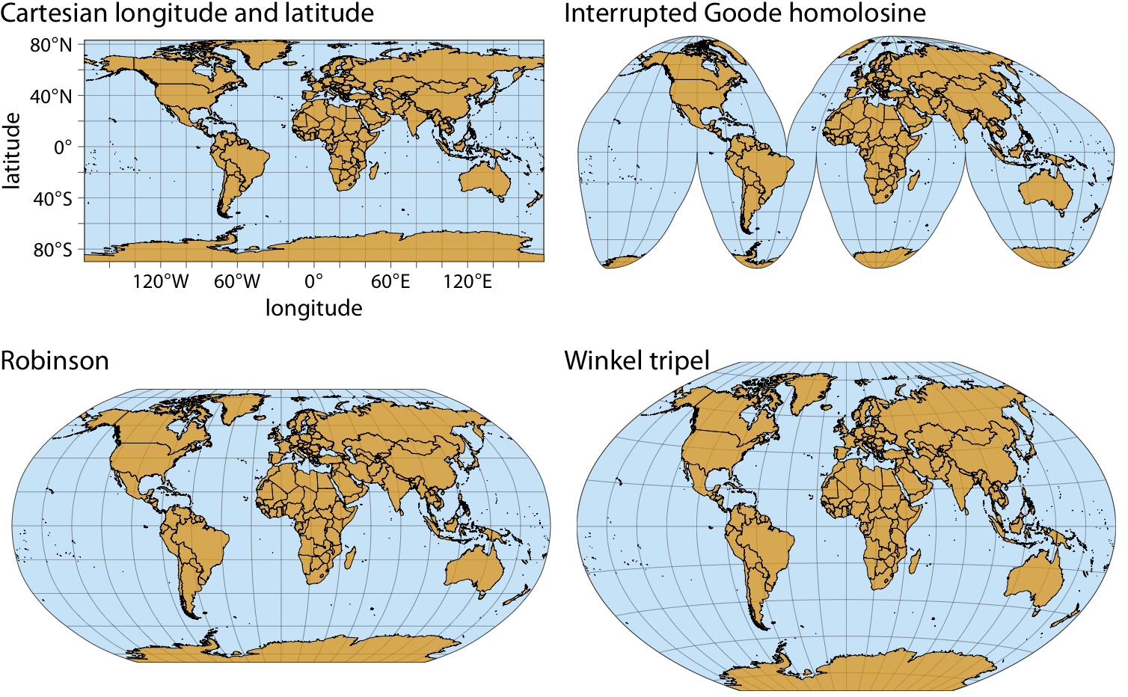
curved axes: Geospatial data

Slide 7
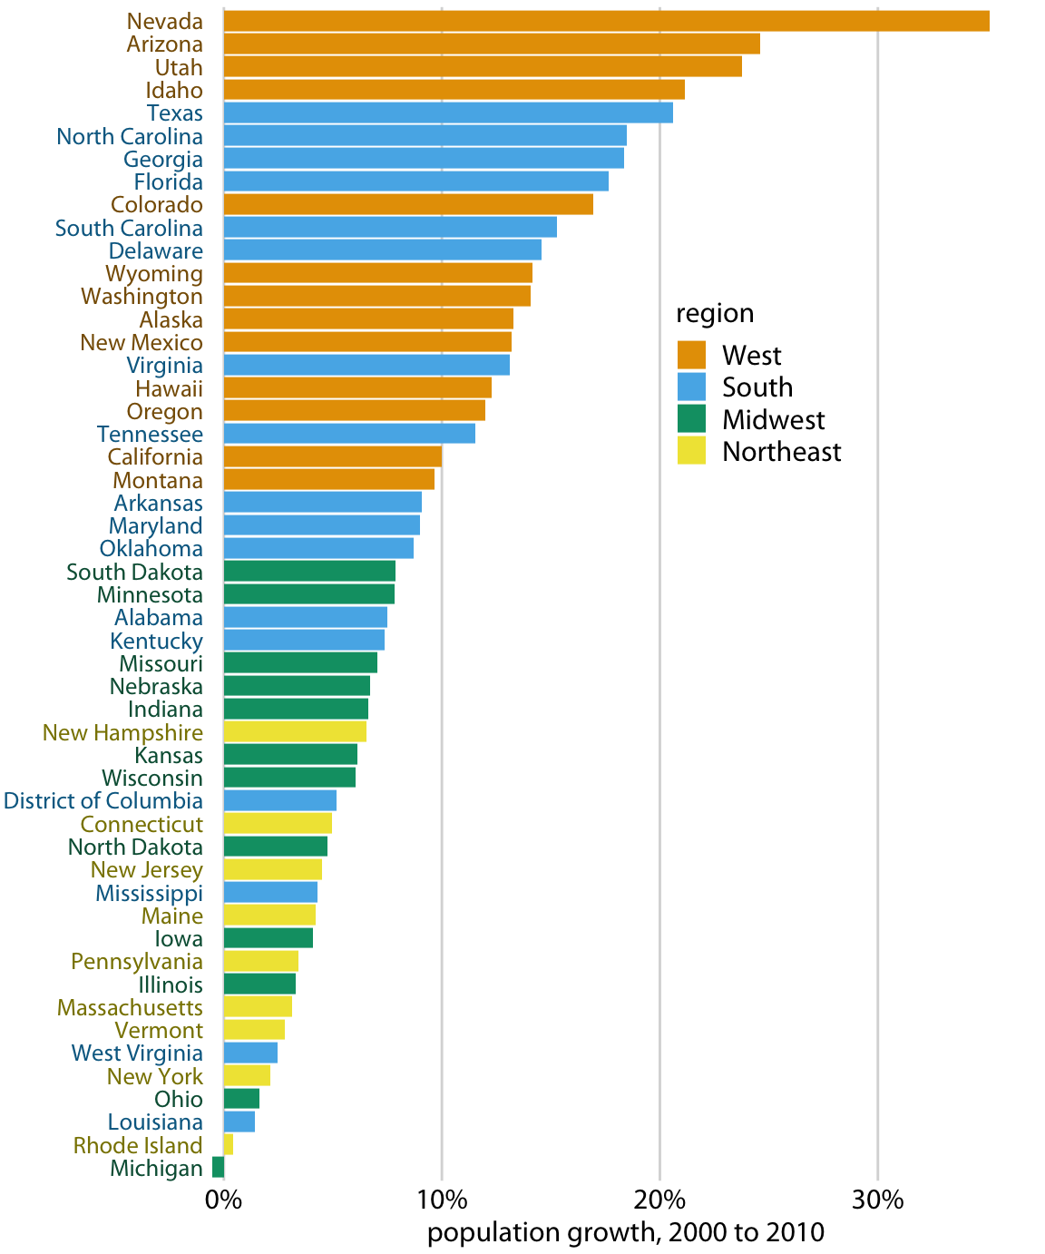
Use of colors in data visualization
Color as a tool to distinguish

Slide 8
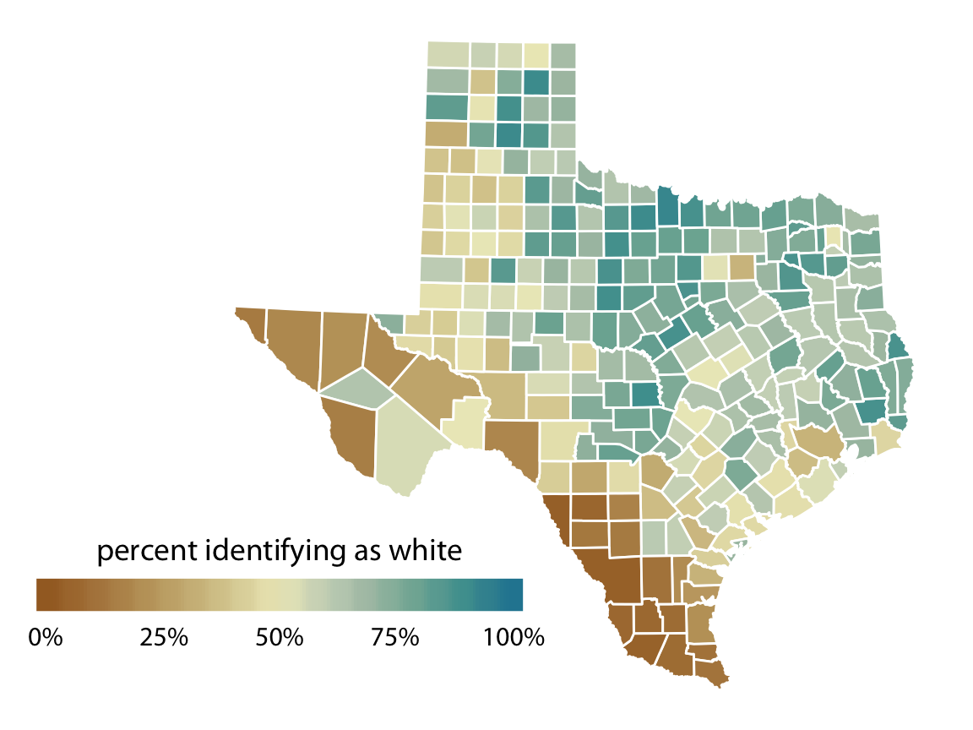
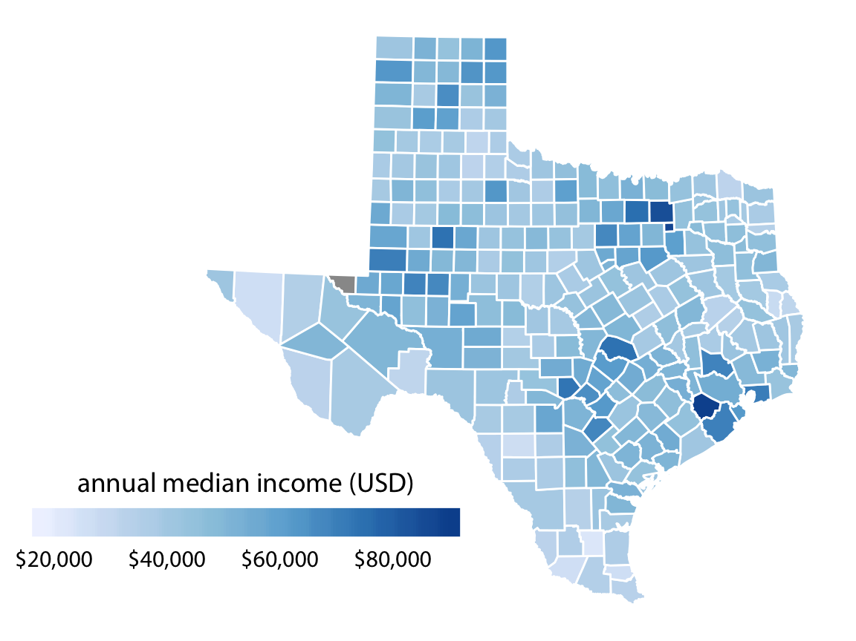
Color to represent data values
Provide a color with a quantitative value.
Give specific color a specific data range.

Slide 9
Color as a tool to highlight
When you need specific data to highlight among large data set.

Slide 10
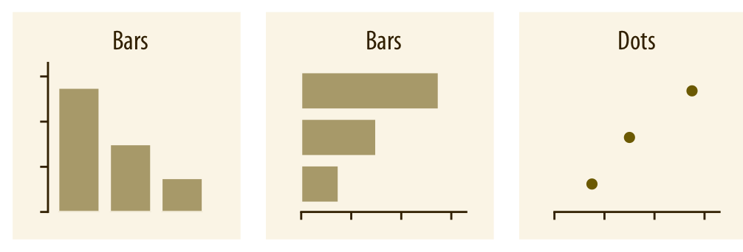
Directory of visualizations:
Amounts

Slide 11
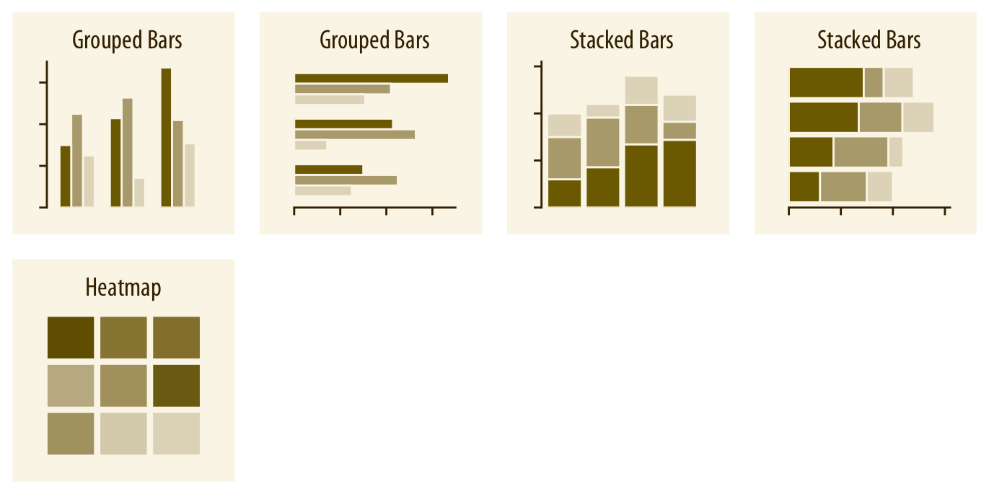
Amounts

Slide 12
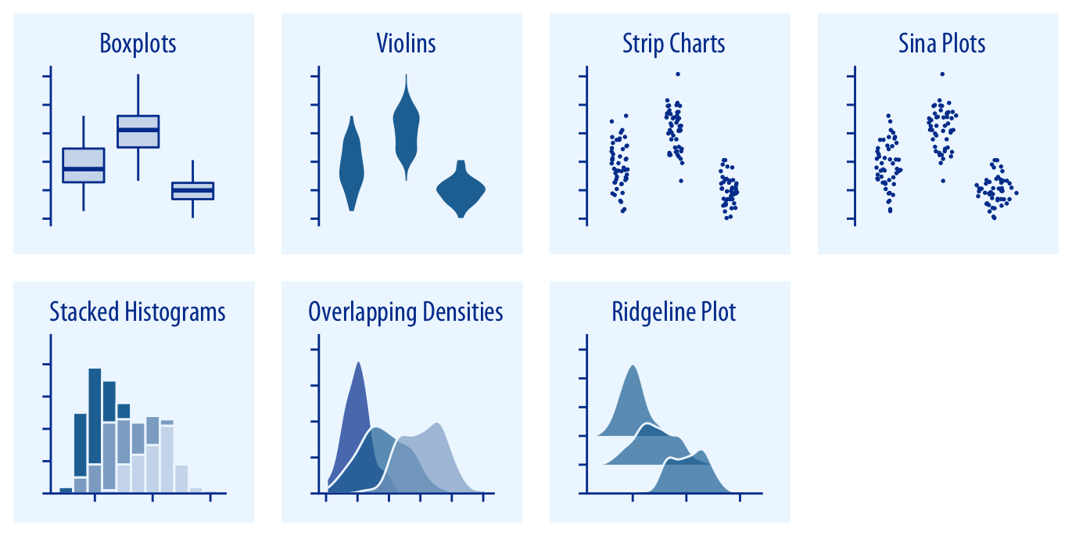
Distributions

Slide 13
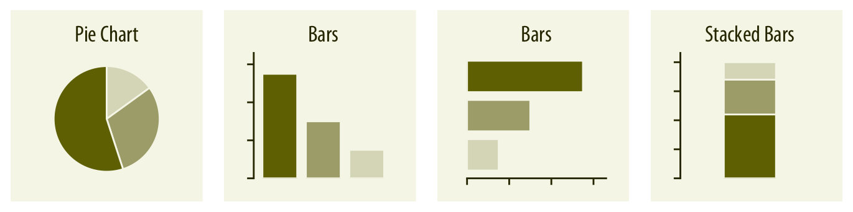
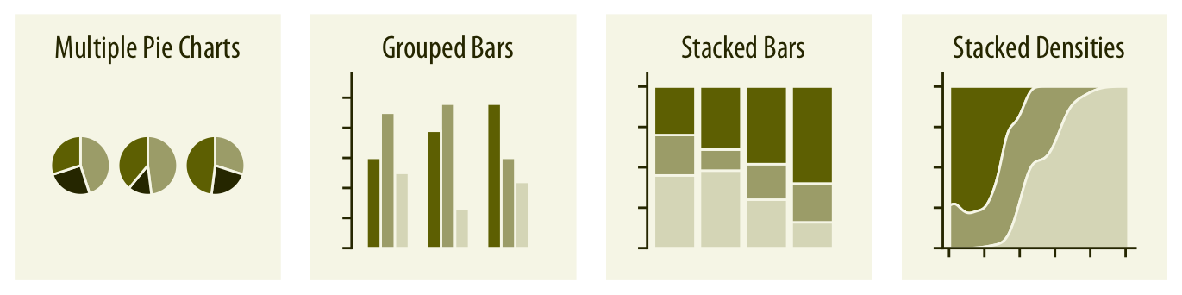
Proportions

Slide 14
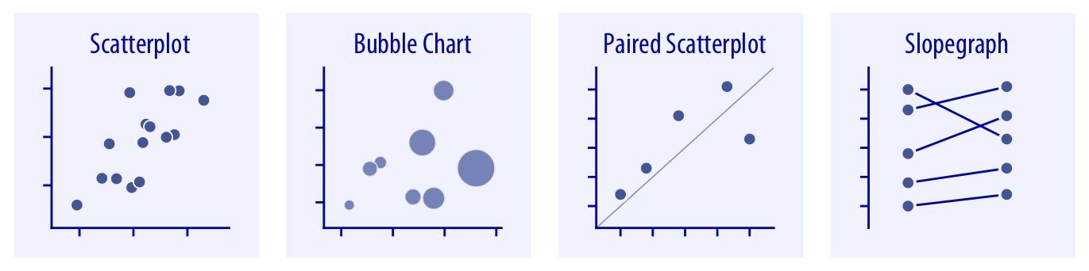
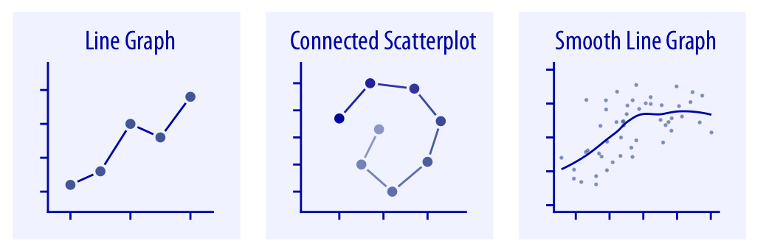
x–y relationships

Slide 15
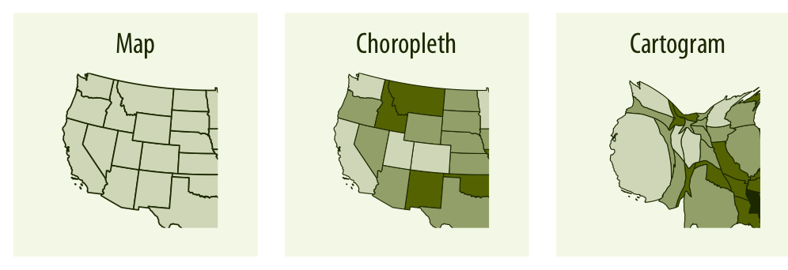
Geospatial data

Slide 16
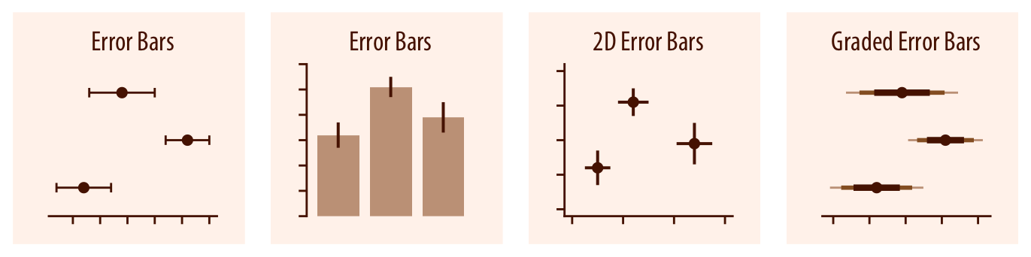
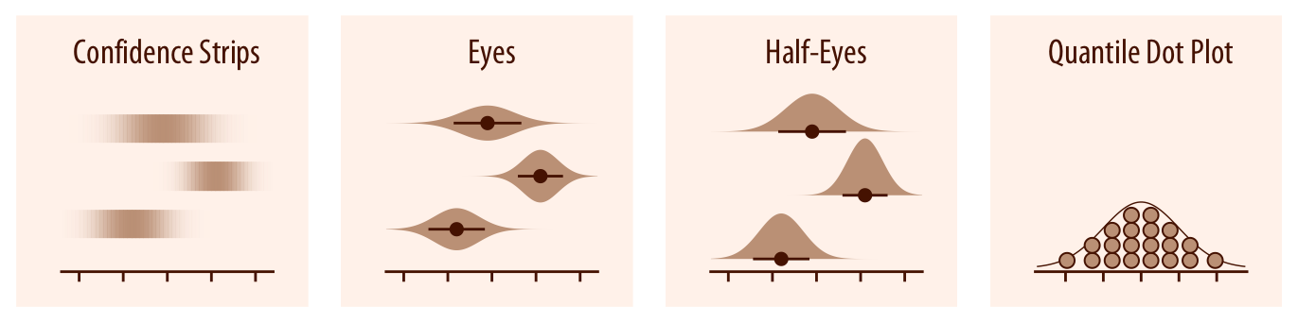
Error Bars

